Slide 1


Toys Sales
Group E

Slide 2
Project Description
Toys Co. is a fictitious retail chain company in Mexico that wants to analyze its sales data from January 2022 to September 2023 to identify trends, optimize inventory, and improve decision-making.
The project aims to uncover insights such as top-performing products, seasonal trends, store performance, and forecast sales for the next two months to support strategic planning.

Slide 3
Project Objective
Using SMART criteria (Specific, Measurable, Achievable, Relevant, Time-bound) to refine objectives:
Analyze sales trends to identify seasonal patterns and optimize promotional strategies.
Identify the top 10 products by sales revenue and profit to prioritize marketing and inventory efforts.
Compare location performance by evaluating revenue contributions across regions to improve strategies.
Examine inventory levels to identify overstocked and high-demand items for better management.
Review product categories to focus on high-performing segments and improve weaker ones.

Slide 4
What makes this project stands out
Comprehensive Analysis:
The project delivers a comprehensive analysis, encompassing overall sales and profit trends, category-specific insights, and regional performance.
Actionable Recommendations:
It doesn't just present data; it provides specific, prioritized recommendations to improve the business.
Interactive and Customizable Dashboard:
The dashboard is designed to be highly interactive, allowing users to dynamically analyze the data based on different metrics. Charts can be easily adjusted to display units, sales, or profits through a user-friendly drop-down menu, providing tailored insights based on specific needs, also features a dynamic year filter that automatically updates with new data, ensuring ongoing utility.

Slide 5
Methodology
Data Source: Maven Analytics Dataset
Tools Used: Python, SQL, and Tableau
Data Structure: Details are provided in the slide
Data Analysis Strategy: Descriptive analysis
1. Collect Data
2. Clean and Prepare Data
3. Exploratory Data Analysis (EDA)
4. Generate Insights
5. Report and Visualize

Slide 6
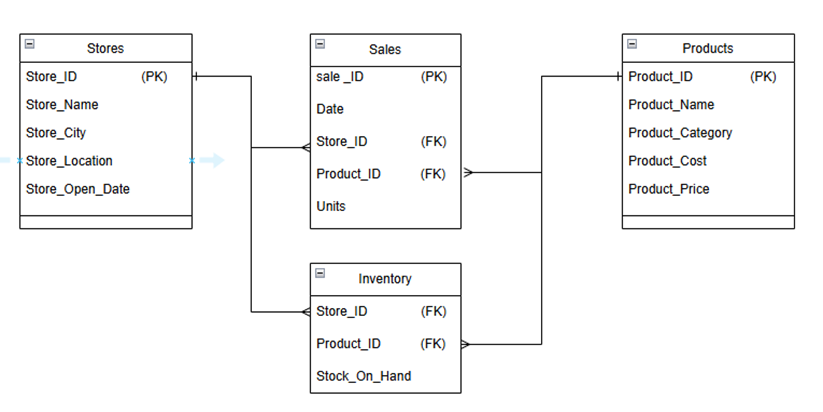
Data Structure
Our dataset consists of four tables, as outlined in the ERD:
1. Stores Table: 5 columns, 50 rows
2. Sales Table: 5 columns, 829,262 rows
3. Inventory Table: 3 columns, 1,593 rows
4. Products Table: 5 columns, 35 rows

Slide 7
Key Observations
1. Declining Sales and Profit: Sales decreased by 6.7% (from $7.5M to $7.0M) and profit decreased by 18.2% (from $2.2M to $1.8M).
2. Category Insights:
Toys remained the top sales category, contributing $2.3M in 2023, despite a $0.5M decline.
Art & Crafts doubled its sales to $1.8M, rising from the smallest to the second-largest category.
3. Regional Dominance: Downtown locations consistently outperformed, contributing 56% of total sales in 2022 and increasing to 57% of total sales in 2023.

Slide 8
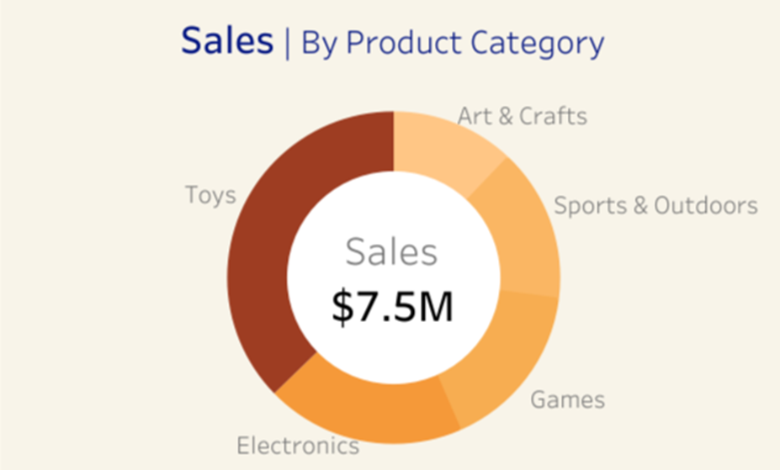
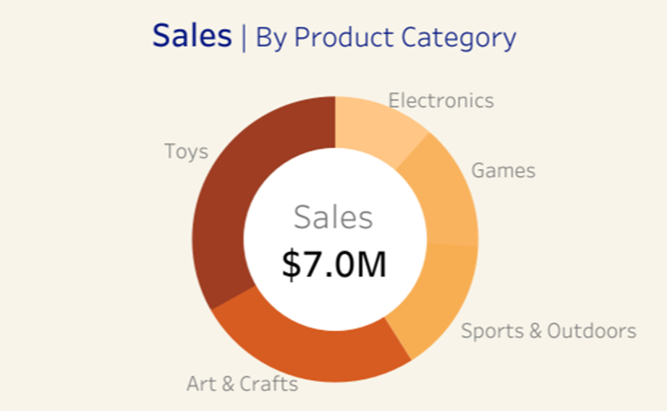
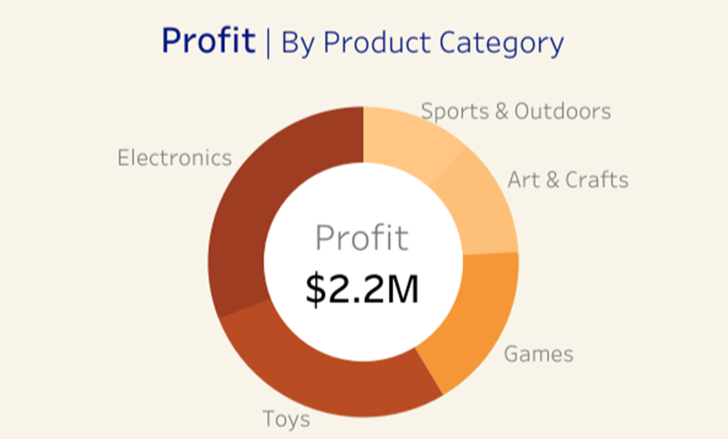
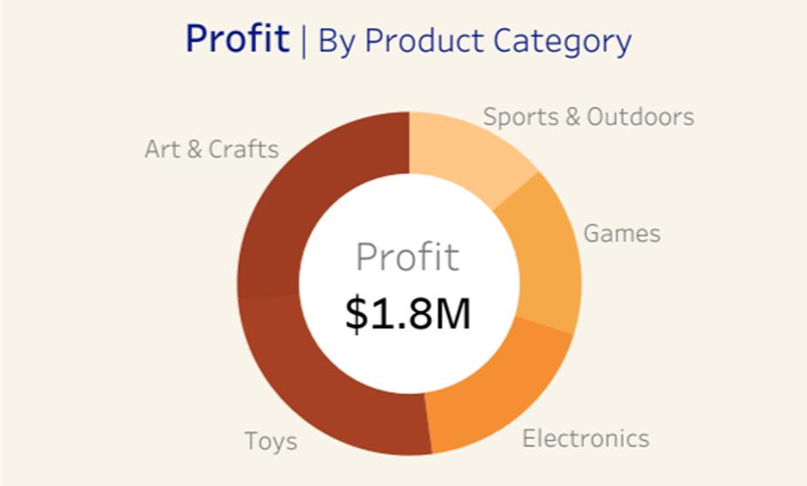
Key Findings
Sales by Category
Profit by Category
Toys: $2.8M → $2.3M (still on top despite a $0.5M drop)
Art & Crafts: $0.9M → $1.8M (Sales doubled, now second-largest category)
Electronics: $674.4K → $327K (Significant decline to be third)
Art & Crafts: $272.9K → $480.4K (From the second-lowest category to the highest in consumer demand)

Slide 9
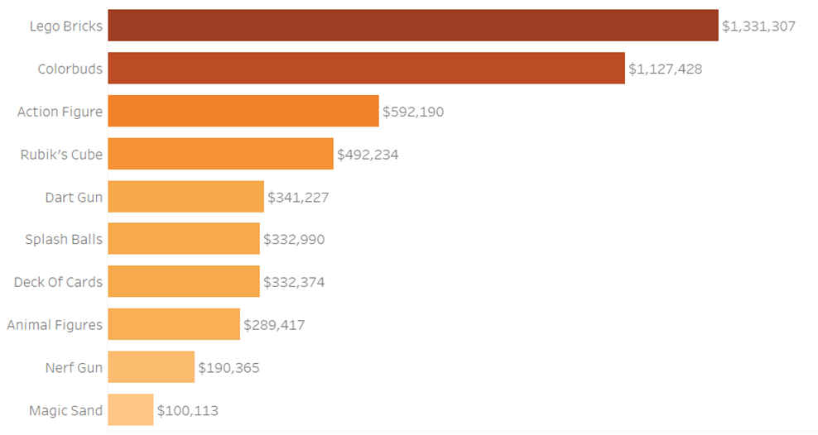
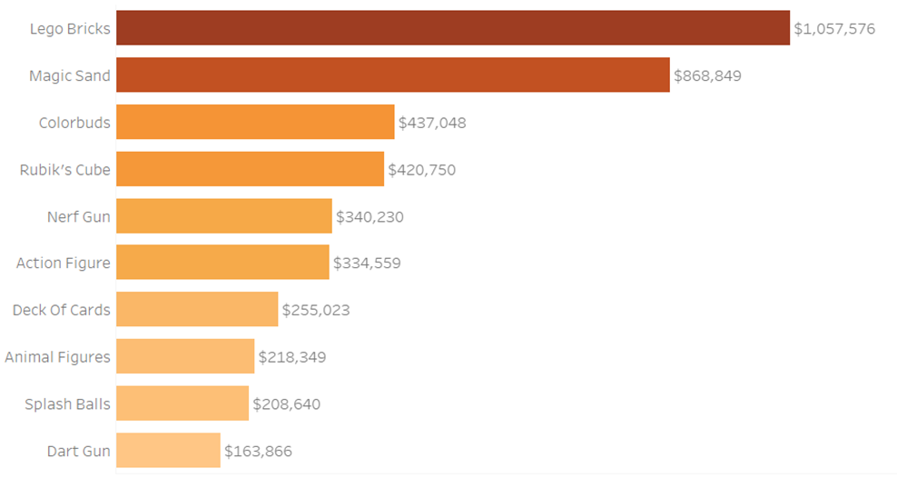
Key Findings
Top Products
By Sales:
2022: Lego Bricks ($1.33M) → Colorbuds ($1.12M) → Action Figures ($592.2K)
2023: Lego Bricks ($1.05M) → Magic Sand ($868.8K) → Colorbuds ($437.0K)

Slide 10
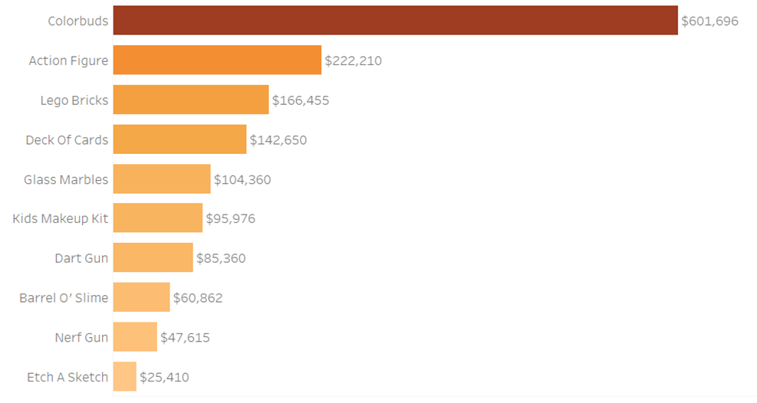
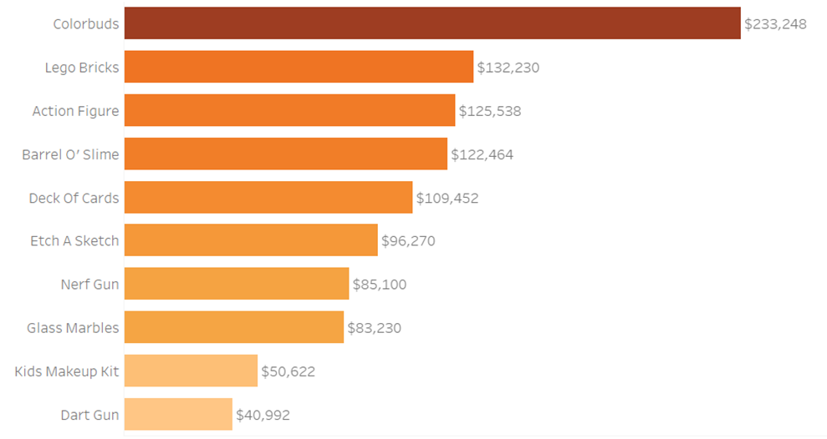
Key Findings
Top Products
By Profit:
2022: Colorbuds ($601.7K) → Action Figures ($222.2K) → Lego Bricks ($166.5K)
2023: Colorbuds ($233.2K) → Lego Bricks ($132.2K) → Action Figures ($125.5K)

Slide 11
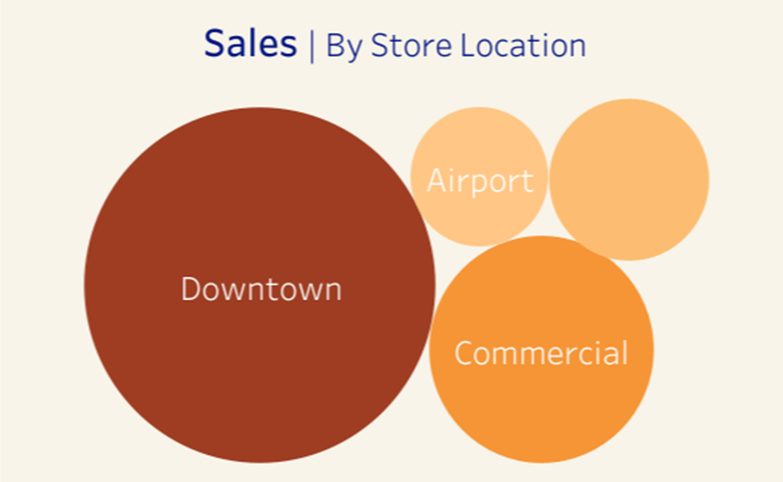

Key Findings
Store Location Performance
2022
Downtown: $4.2M sales (56%) | $1.2M profit (55%)
Airport: $0.7M sales (9%) | $205.0K profit (9%)
2023
Downtown: $4.0M sales (57%) | $1.03M profit (57%)
Airport: $0.6M sales (9%) | $173.0K profit (10%)

Slide 12
Recommendations
High Priority
1. Focus on Growing Categories:
To sustain strong growth, increasing inventory and marketing efforts for Arts & Crafts products could add an estimated $0.5M in annual sales, further strengthening their contribution to the business’s success.
2. Electronics:
Review Electronics pricing, introduce new products, and launch targeted campaigns to recover 10% of 2023’s lost profit ($65K), strengthening overall profitability.
3. Inventory:
Optimize inventory by reducing overstock of slow-moving items (e.g., Deck of Cards) and securing sufficient stock for high-demand products (Color Buds, Lego Bricks, Action Figures) to improve cash flow and cut storage costs.

Slide 13
Recommendations
Medium Priority
4. Expand Downtown Advantage:
Launch loyalty programs and targeted promotions at Downtown stores to leverage their dominance, boosting customer retention could add an estimated $0.3M in annual revenue.
5. Leverage Seasonal Trends:
Leverage historical data to optimize seasonal promotions for especially Toys and Arts & Crafts during peak holidays, driving a 5% increase in seasonal sales translating to an additional $0.35M in revenue.
Low Priority
6. Investigate Underperforming Locations:
Analyze customer feedback and operational challenges at underperforming Airport and Residential stores to halt declines and stabilize performance.

Slide 14



Deliverables
Dashboard
Documentation
GitHub

Slide 15
Team Members
Dalia Fawzi Noah
Sondos Abd El-Razek Ahmad
Ahmed Fayez Abdel Monem
Malak Ayman Elmarasy
Esraa Selim
Nada Amin Elgamal

Slide 16

Thank You

